Slide 1
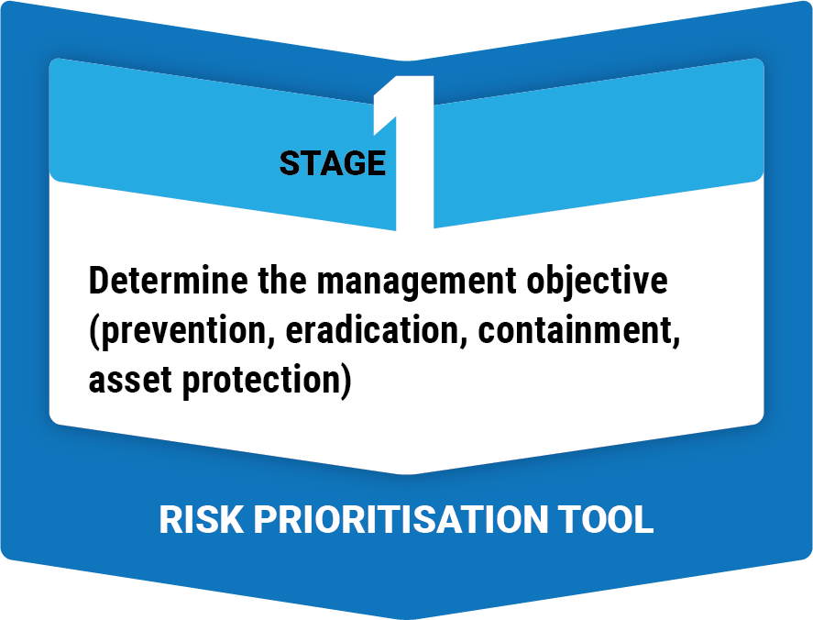
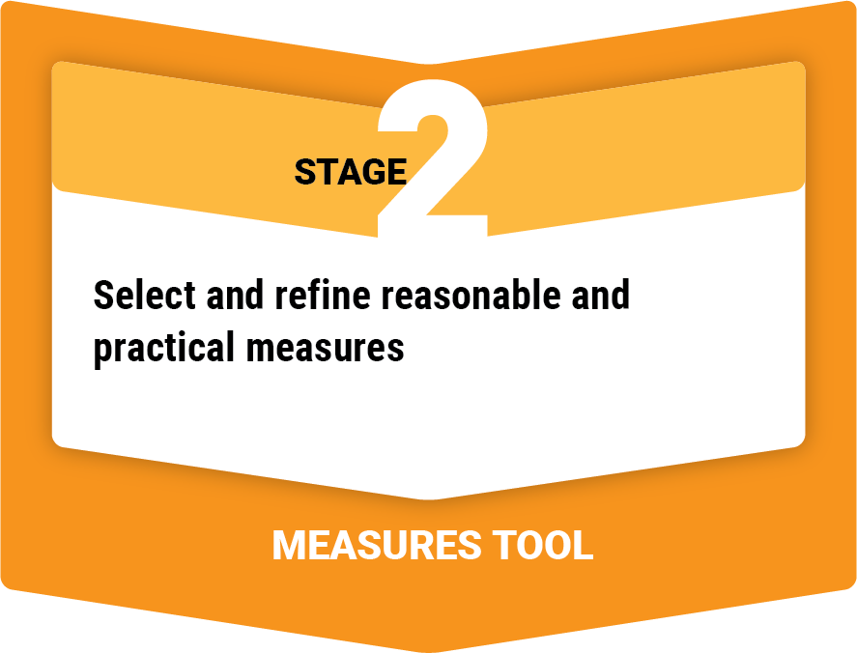
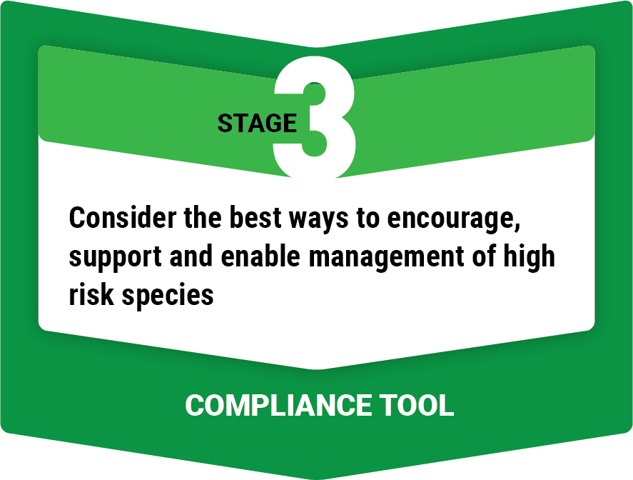
Developing practical tools to support biosecurity legislation
Matt Sheehan and Shauna Potter
Acknowledgements: Biosecurity Queensland (Kym Johnson)
Local Government Association of Queensland (Kristy Gooding)
Notes:
Hello, my name is Matt Sheehan, joining you from Dja Dja Wurung country. Thankyou for joining me for my presentation on Developing practical tools to support biosecurity legislation .
I would like to acknowledge my co-author, Shauna Potter, and our partners, Biosecurity Queensland and the Local Government Association of Queensland.

Slide 2
Biosecurity reform in Australia
Australia has seen significant biosecurity reforms in the past decade.
Biosecurity and Agriculture Management (BAM) Act WA (2007)
Biosecurity Act Qld (2014)
Biosecurity Act NSW (2015)
Biosecurity Act Tas (2019) – in transition phase
The Weeds Management Act 2001 NT
Amendments passed Department preparing for implementation
ACT – Bill being drafted
SA – consultation progress underway
Victoria - review in progress
Notes:
[audio finalised]
As many of you are probably aware, Australia is going through a process of significant biosecurity reform, both at the national and state/territory level.
We are talking post boarder biosecurity here, so I will focus on the state and territory legislation.
[CLICK] Western Aust, Qld and NSW all put in place new biosecurity legislations over the last 6-15 years and these are now in use.
[CLICK Tasmania and the Northern Territory are in a transitional phase, where legislation has passed through their parliaments and now they are in the process of developing regulations and implementing them
[CLICK] ACT, SA and Victoria are still operating under older legislation but are in the early stages of reform, including stakeholder consultation and review processes and drafting new bills.

Slide 3
Simpler, more effective legal framework
Management
Invasive species
Pests
Diseases
imports of plant and animal products
biosecurity emergencies
monetary reimbursement for biosecurity related loss
Notes:
In all cases the reforms seek to provide a simpler and more effective legal framework for the management of invasive species, pests, diseases and a range of other Biosecurity matters

Slide 4
Biosecurity Act Qld (2014)
Notes:
In many cases the reforms have seen multiple legislation replaced with one over-arching Act.
[CLICK] Today we are going focus on the Qld biosecurity Act, however much of what I discuss could have relevance to the implementation of legislation elsewhere.

Slide 5
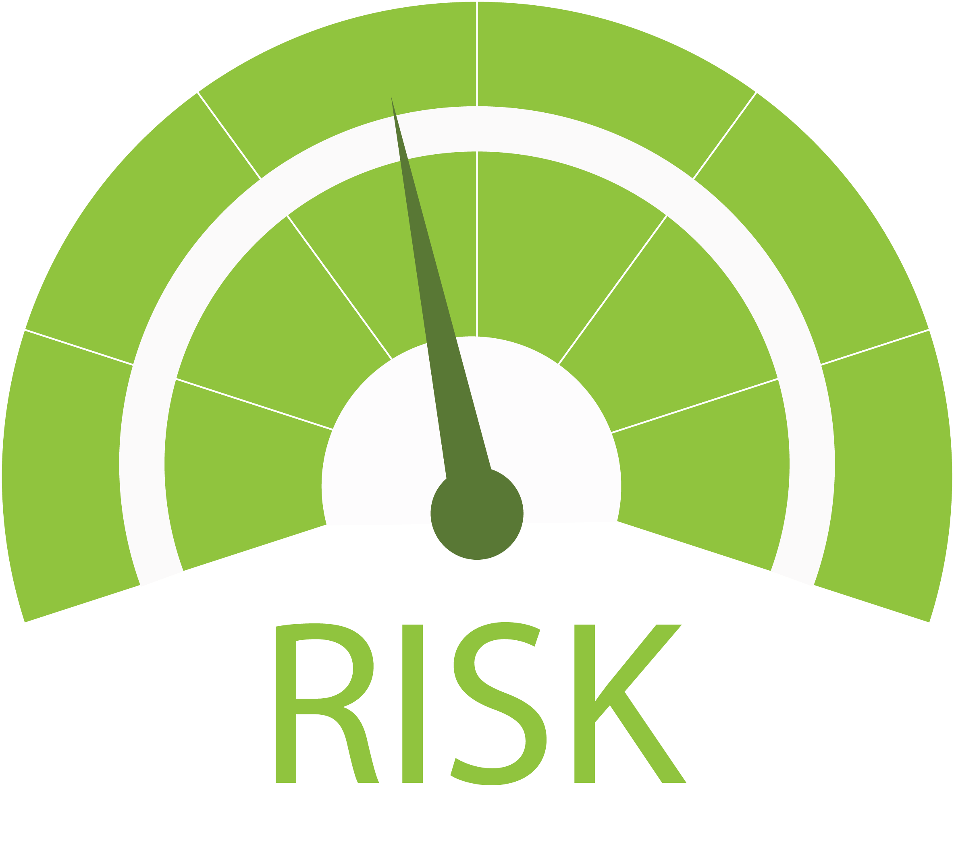
Biosecurity reform in Australia
Common concepts:
Risk-based decision making
Requirements to take ‘reasonable and practical’ management actions to reduce the risk, based on the level of biosecurity risk posed
Shared responsibility and tenure-blind
application of the precautionary principle
Notes:
[audio finalised]
The reforms have brought about a fundamental change to the ways declared species are defined and categorised
And while the new legislation still has difference between jurisdiction there are certainly comment concepts.
They all take a significant step away form, prescriptive, species based management requirements of past legislation move towards
[CLICK] risk based-decision making
and [CLICK] a requirement to identify ‘reasonable and practical measures’ to reduce biosecurity risk.
[CLICK] Additionally the is a greater emphasis on the concept of shared responsibility,
[CLICK] and also in applying the same management responsibility to all land managers across all land tenures
[CLICK] the approach is considered to take a precautionary approach, enabling it to respond to new species that are found to present a risk
Measures may look different depending on the situation (including such considerations as landholder capacity).

Slide 6
Biosecurity Act Qld (2014)
General biosecurity obligation
(1) a person who deals with biosecurity matter… knows or ought reasonably to know that the biosecurity matter, carrier or activity poses or is likely to pose a biosecurity risk.
(2) The person has an obligation (a general biosecurity obligation) to take all reasonable and practical measures to prevent or minimise the biosecurity risk.
This Photo by Unknown Author is licensed under CC BY-NC-ND
The Act/regulations do not define these terms!!!
Notes:
[audio finalised]
I am going to give an example now from the Qld Biosecurity Act of the typical wording within biosecurity legislation.
[CLICK] The Act puts in place a General Biosecurity Obligation, that states that a person that deals with, say weeds. [CLICK} should know, or ought reasonably to know that a given weed is likely to pose a biosecurity risk AND
[CLICK that the person should take ‘…all reasonable and practical measures to prevent or minimize the biosecurity risk’
The act and its regulation does not define these terms.
So, we have gone from a situation under past legislation which has been highly prescriptive and species list based, to legislation where the onus is on the person who deals with biosecurity matter, knowing what the risk will be and knowing how to appropriately reduce that risk.
The Acts or the regulations are not prescriptive in describing what is
reasonable to know about risk OR
What action is reasonable and practical to reduce the risk

Slide 7
Biosecurity ACT Qld (2014), Section 53
Local Government required to have Biosecurity Plans that include:
(a) achievable objectives, based on risk
(b) strategies, activities and responsibilities for achieving the objectives
(c) strategies to inform the local community about the content of the plan and achievement of its objectives
Notes:
[audio finalised]
But the Act, under section 53, clearly stipulates that Local government must have processes to identify how they will achieve this.
So each local government is required to have a Biosecurity Plan, which includes:
So it’s the role of LG to identify local priorities, management measures and associated compliance responses all based on risk.
This brought LG much closer to decision making than before- and with this came some challenges.
And just to put it into context - there are 77 LG across Qld!

Slide 8
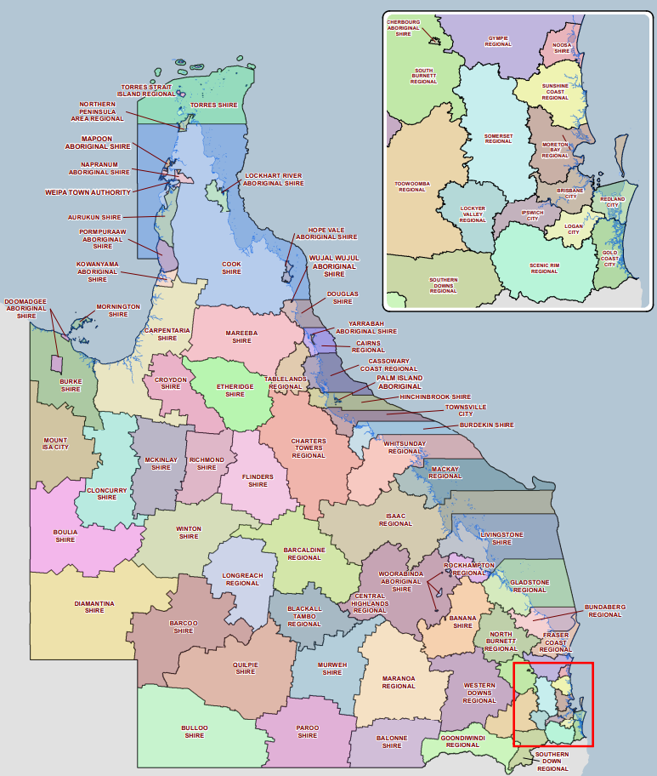
Local Gov.
Local Gov.
77 LGAS statewide
Highly variable:
resources
Land areas, and situations
Capacity and capability
Has put more responsibility on LGAS
has been a difficult transition for LGAs
Some LGAs want assistance
Legislation
Interpretation
Implementation
Notes:
[audio finalised]
So not only is Local government responsible for implementation of biosecurity legislation, under regulations of the new act, they are also responsible for interpreting it.
So it’s the role of LG to identify local priorities, management measures and associated compliance responses all based on risk.
This brought LG much closer to decision making than before- and with this has come some challenges.
And just to put it into context - there are 77 LG across Qld!
[CLICK]
With wildly differing situations, size and capacities. For example, some highly populated LGAs may been smaller geographic areas with a larger rate base, more weed offers to share the load of these added responsibilities and access to expertise to help develop risk based biosecurity plans
The decision to not be too prescriptive on how to apply the Act was a deliberate one, so that LGAs responsible for implementing the Act had autonomy in how they would go about it.
However, it has turned out that guidance in interpreting the new Act and having some state consistency was something that many LGAs wanted.
Biosecurity Qld and LGAQ developed a project to ease this transition and bring Local government along on the journey

Slide 9
Developing tools for biosecurity planning
Objective:
develop best practice biosecurity planning and compliance tools and systems for use by Queensland local governments to support the implementation of the Biosecurity Act 2014.
Tool requirements:
scalable
support biosecurity planning processes.
Notes:
[Audio OK]
This led to a joint project by BQ and the LGAQ to develop tools to support biosecurity legislation.
The key objectives of the project was to develop best practice biosecurity planning and compliance tools and systems for use by Queensland local governments to support the implementation of the Biosecurity Act 2014 (the Act).
Tools had to be
scalable across different types and complexities of biosecurity risk and local government capacity and
support rigorous and collaborative biosecurity planning processes.

Slide 10
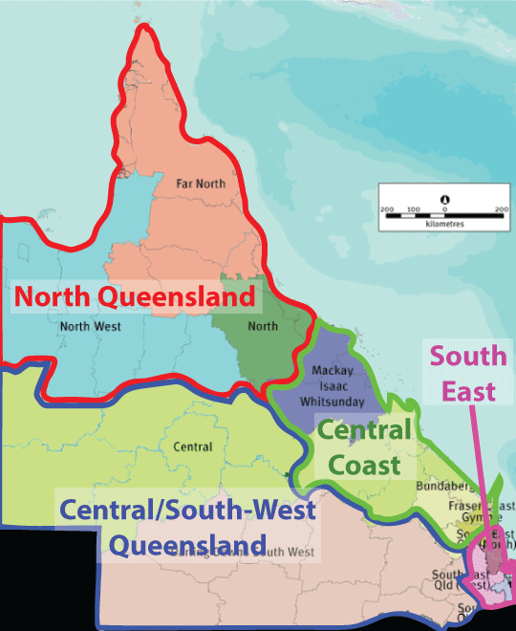
Assist LG in determining risk to address the Acts requirement to ‘ought reasonably to know’
Address the acts requirement for land managers to take all reasonable and practical measures to prevent or minimise the biosecurity risk.
Assist Local Government in communicating biosecurity risk, practical measures and encouraging land managers to meet their obligations
Notes:
[ideally needs re-recording but will do it I run out of time]
When we started on this project we thought it was logical to match the tools with the major elements of the Act: risk, measures and compliance.
But we also thought it was important to ground truth this approach with weed officers. So we conducted workshops through Queensland and found that our approach was supported, weed officers were the engaged in the codesign of the tools.
[CLICK] The risk tool assists LG in determining risk associated with different species and really helps define what a person ‘ought reasonably to know’ about risk
The measures tool Address the acts requirement for land managers to take all reasonable and practical measures to prevent or minimise the biosecurity risk.
And the compliance tools was to assist Local Government in communicating biosecurity risk, practical measures and encouraging land managers to meet their obligations
In developing the tools it was really important for us to ensure they were based on accepted, evidence based scientific approaches, whilst being accessible to weed officers, easily digestible, diagram heavy with easy steps to follow.
It was also important that the tool was scalable and adaptable .

Slide 11
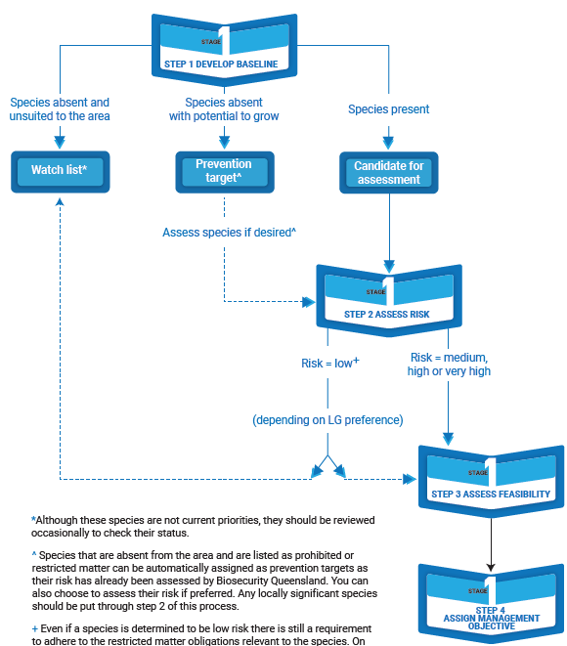
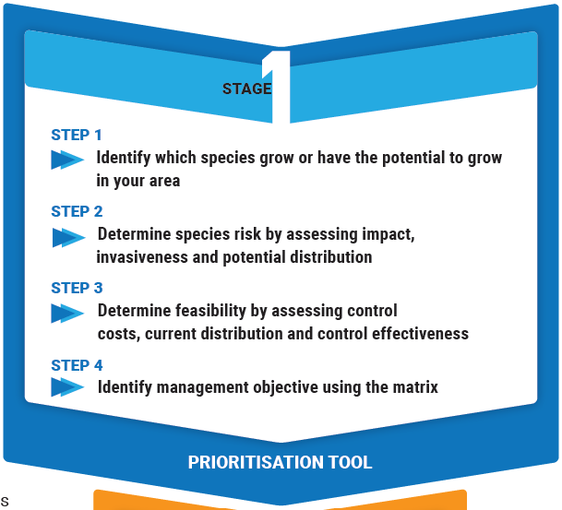
Notes:
[Audio OK]
Tool 1 assesses risk (for both weeds and pest animals) based on the Australia standard risk
assessment approaches but is simplified to enable adoption by LG that may have with limited technical capacity.
The tool firstly sets out the steps, and then each step is elaborated on to lead the user through the technical process.

Slide 12
Notes:
[Audio OK]

Slide 13
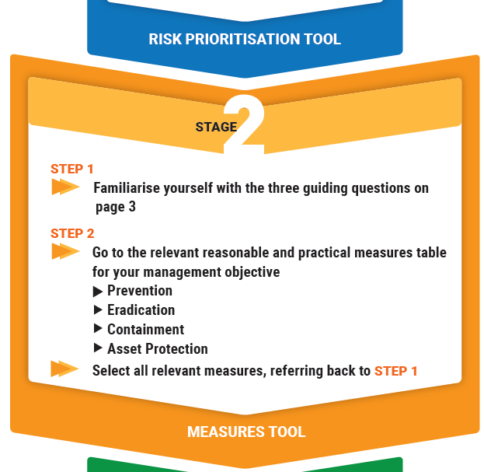
Notes:
[audio finalised]
Once we know the risk and have assigned a management objective, we then need to know what can reasonable and practically be done to reduce the risk and achieve that management objective.
This 2nd tool – the measures tool is a list of control activities that if adopted, [CLICK] are likely to lead to one of the four management objectives listed here I would also like to acknowledge that this tool is adopted from the approach use to identify measures in NSW under their biosecurity Act.
It also has a build it reality check, asking the user when selecting measure form the list to ask three simple questions:
Is ol cover both weeds and pest animals, so a hygiene measure may not reduce the risk of a large vertebrate pest establishing.
Will the measure reduce risk )e.g. a 30 buffer zone may not reduce risk of a wind dispersed weed, and
Is there any other measure missed in the list. These are suggestions and are not exhaustive.

Slide 14
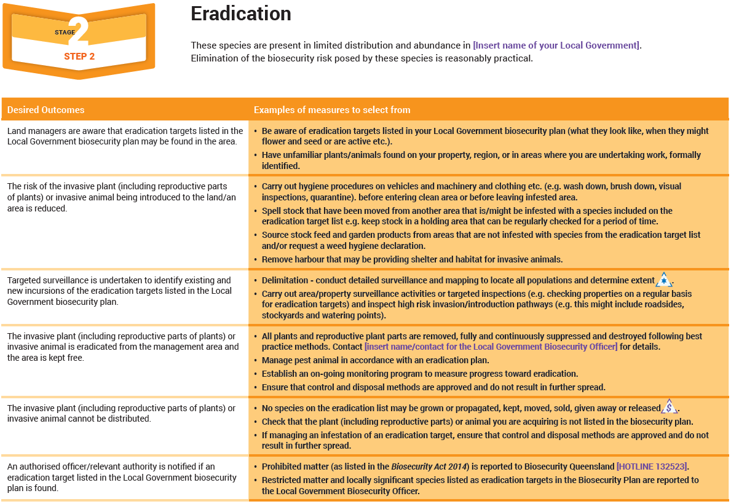
Notes:
[needs re-recording]
This is the ERADICTION measures table and it essentially provides a starting point for LG staff to pick/mix/modify measures to suit the situation
The table outlines some of the desirable outcomes OF ERADICATION and gives examples of measures that might achieve them.
For example, the tool suggests that for an eradication target it would be reasonable and practical to expect a land manager to remove all reproductive plant parts following best practice methods..

Slide 15
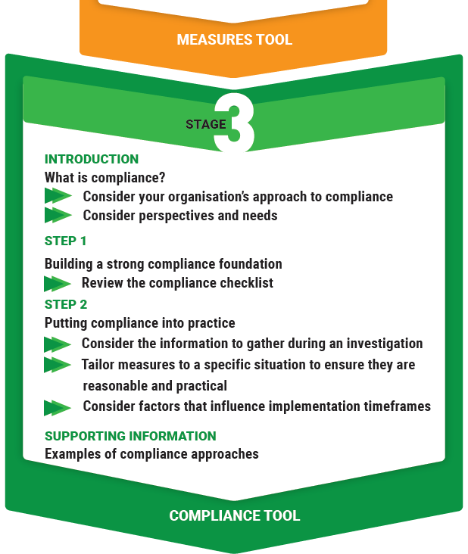
Notes:
[audio finalised]
THE FINAL TOOL IS ABOUT COMPLIANCE
Compliance remains a challenge to LG and BQ. LG is reticent to enforce compliance in communities they live and work in, and yet the responsibility under the Act clearly sits at the LG level. BQ have been providing additional training in compliance, in recognition that voluntary compliance alone is often not enough to achieve an acceptable reduction in risk.
Compliance tool was about brining LG along the journey that there was more than just voluntary compliance (that’s something they are still struggling with)

Slide 16
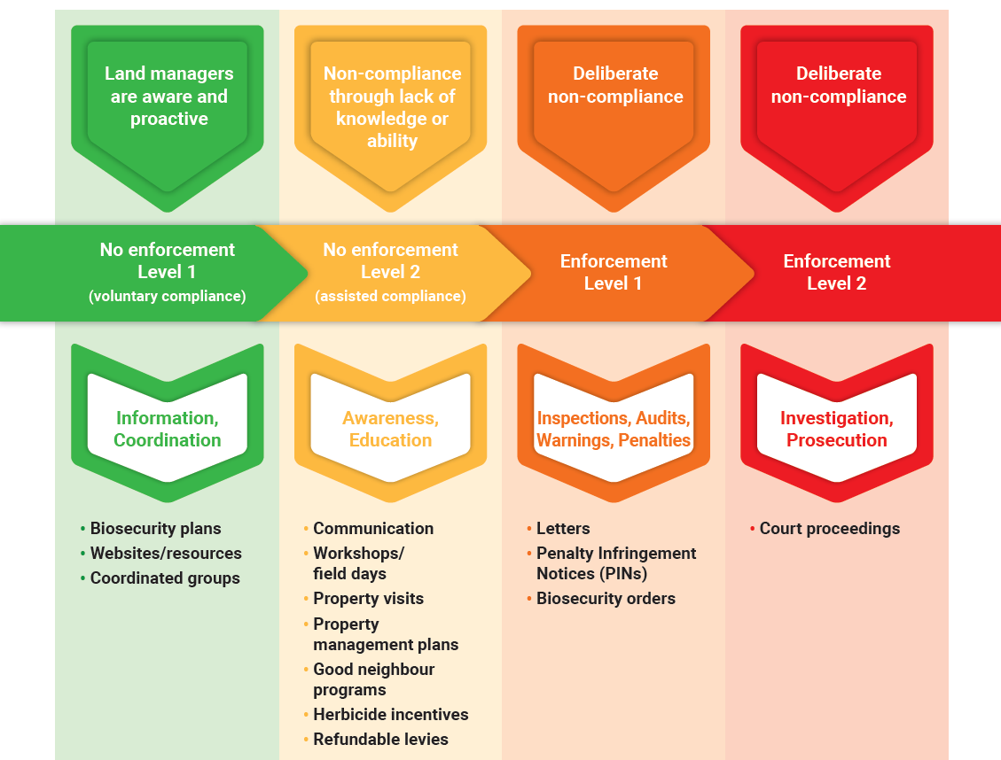
Notes:
[audio finalised]
Consultation with weed officers in the development of the tools showed that there were misconceptions about what compliance is. Many equate compliance to enforcement – e.g. serving a notice or perusing court action, which many councils do not have the desire or the capacity to pursue. So the first step was to explain compliance, and we did that by representing it as a spectrum and showing the range on compliance response options available to them along that spectrum.
This tool helps weed manager explores what options they have available to them. It asks LGs where they sit along this spectrum currently, and where, based on LG capacity and land managers knowledge, capacity and attitudes, where they need to sit or want to sit.

Slide 17
Tool uptake and use
Online training delivered to 46 councils statewide
Tools being used and adapted across Qld LGAs
Cook
Douglas
Hinchinbrook
Burdekin
Leading to greater understanding of the new legislation and how to apply it locally
Leading to greater consistency in the approach to biosecurity decision making across Queensland
Notes:
[AUDIO FINALISED]
Following the development of the tool`s, 46 councils statewide were trained in their use, and as a result tolls are being adopted and adapted across Queensland.
Many local government haven't utilised the tools yet as they have active plans in place, but as more plans come up for their periodic review, LG are looking to the tools for guidance and consistency. The tools are also being actively promoted by BQ and regional organizations.
While we haven’t investigated statewide uptake, here is a snapshot of Far North Queensland, where the tools have been used in revised biosecurity plans of 4 councils so far.

Slide 18
Thank you!
www.wildmatters.com.au
Notes:
This presentation has provided one example of how interpretive tools can help statutory authorities adapt to legislative change, empower them and enable them to be campions on the biosecurity approach.

